Slide 1
Socket io project
Rylee, Becca

Slide 2
Assignment Goals
Create a real-time voting system where users can vote on a question and see results update instantly for everyone.
Use Socket.IO for real-time communication
Send events from client to server
Broadcast data to all connected clients
Update the web page dynamically
Work collaboratively as a team

Slide 3
Approach used to complete the assignment
Come up with a plan together on what we want the finished product to look like.
Work together to complete the requirements and divide work evenly to break up the project and help with the workload.
Communicate any issues or question between each other and to keep updating each other on progress towards the project goal.

Slide 4
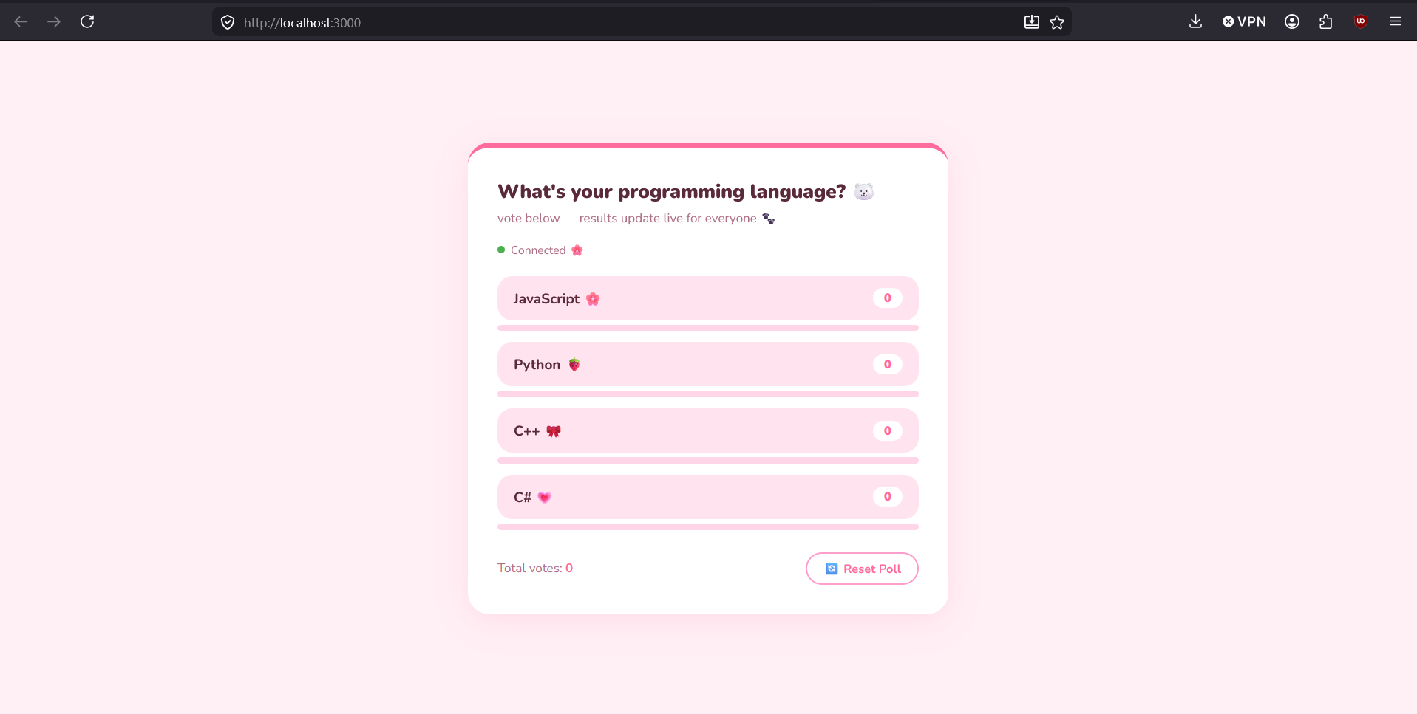
Code Examples

Slide 5
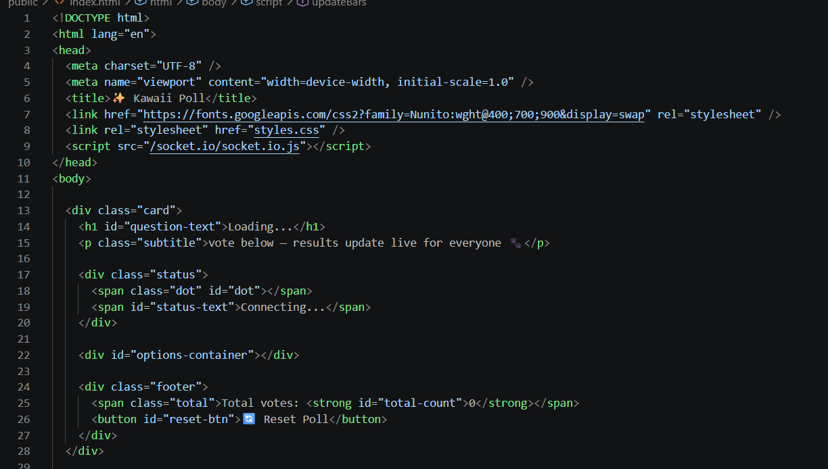
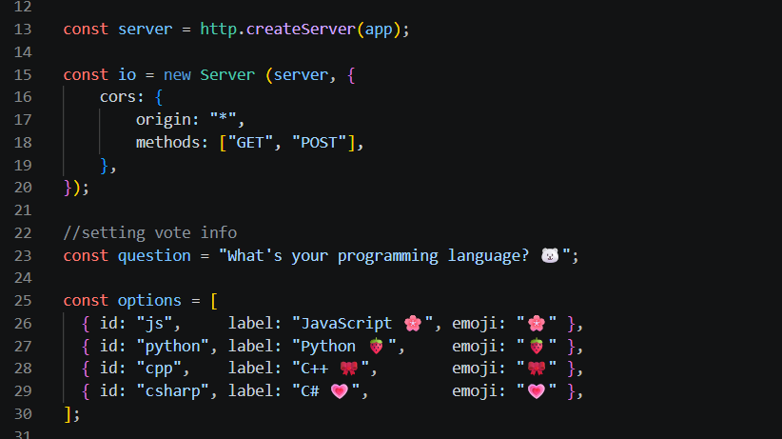
Code Examples

Slide 6
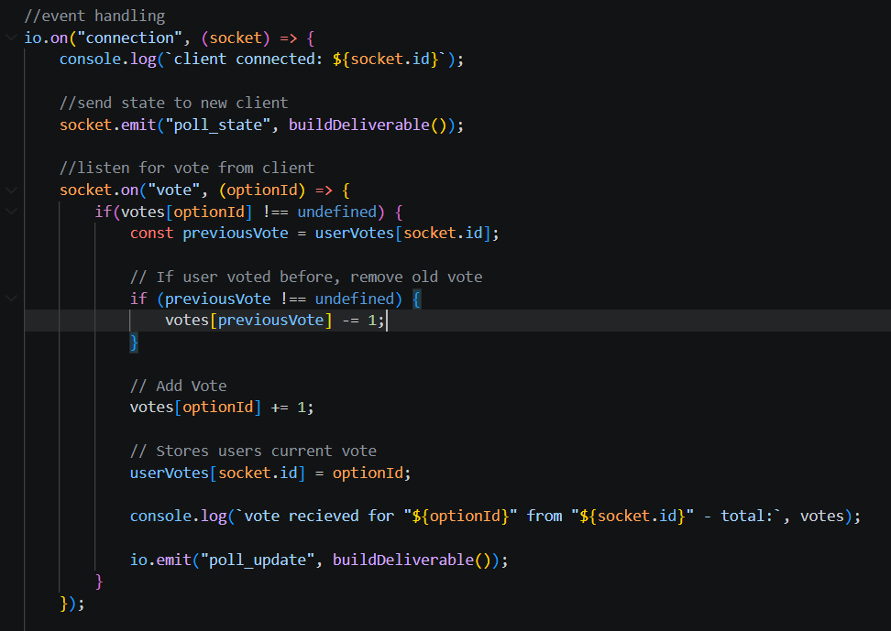
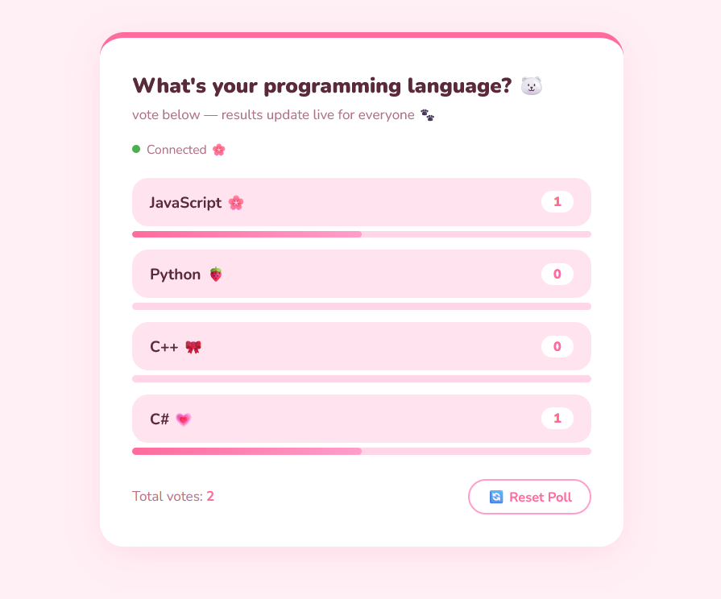
Code Examples

Slide 7
Debugging and Testing
For testing this application, the main method was starting the server and testing it in the browser to see if it was functioning correctly.
Debugging was checking to make sure a user was limited in how many votes they could cast and allowing users to change their vote.
The function that was the focus of debugging was the vote function and required the most attention to make sure it was working correctly.

